Slide 1
Expression invariant face recognition
Sumit Agrawal Piyush lahoti

Slide 2
DATASET Preparation
First things first

Slide 3
DAtabase
We are using Cohn–Kanade database.
Database consists of 100 university (CMU) students.
Aged 18-30
65% Female
15% African American + 3% Asian or Latin American
6 Prototypic emotions : Fear, Surprise, Sadness, Anger, Disgust, Joy and Neutral image.

Slide 4
Crop-o-norm
We wrote this tool kit to efficiently extract facial region out of the image.
Clicking on eyes is enough to crop face out of the image.

Slide 5
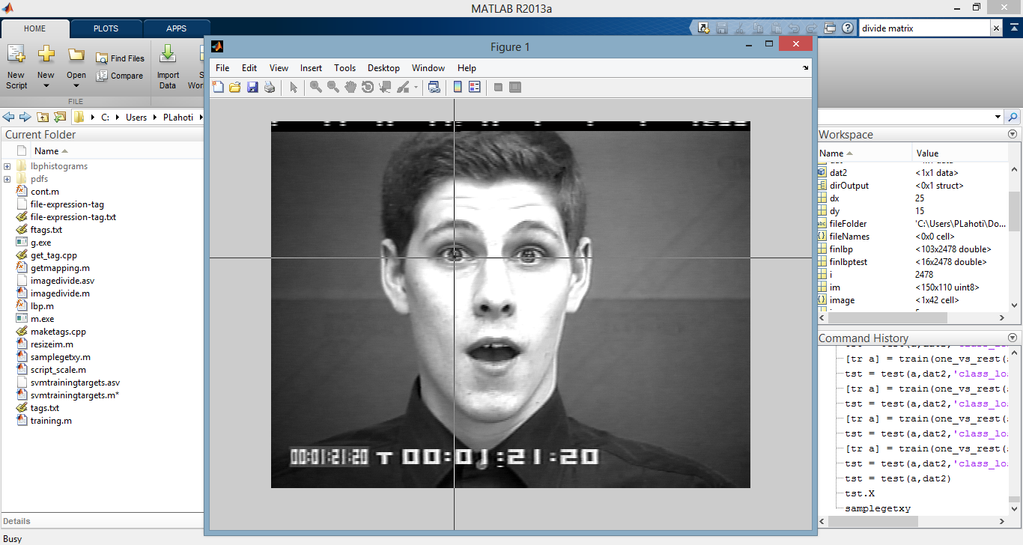

Slide 6
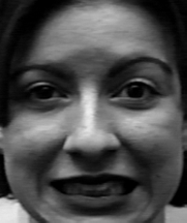
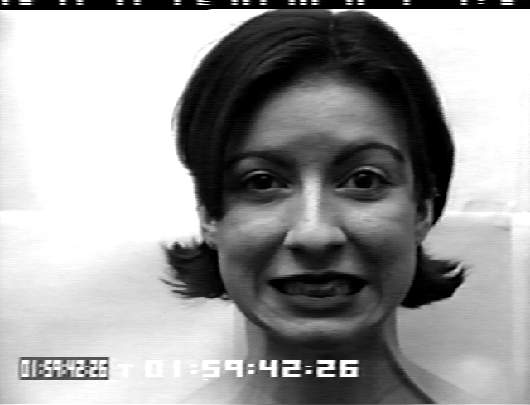
CROP-O-norm : Results
Fig. 2

Slide 7
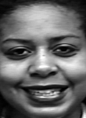
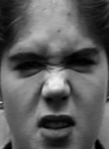
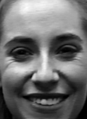
Normalization

Slide 9
Extraction of expression tag
We have implemented Local Binary Patterns(LBP) for e
We are using open source ‘SPIDER’ Matlab library

Slide 10
Local Binary Patterns
[1]The LBP feature vector, in its simplest form, is created in the following manner:
Divide the examined window into cells (e.g. 16x16 pixels for each cell).
For each pixel in a cell, compare the pixel to each of its 8 neighbors (on its left-top, left-middle, left-bottom, right-top, etc.). Follow the pixels along a circle, i.e. clockwise or counter-clockwise.
Where the center pixel's value is greater than the neighbor's value, write "1". Otherwise, write "0". This gives an 8-digit binary number (which is usually converted to decimal for convenience).
Compute the histogram, over the cell, of the frequency of each "number" occurring (i.e., each combination of which pixels are smaller and which are greater than the center).
Optionally normalize the histogram.
Concatenate (normalized) histograms of all cells. This gives the feature vector for the window.

Slide 11
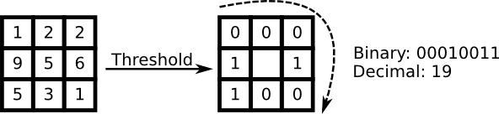
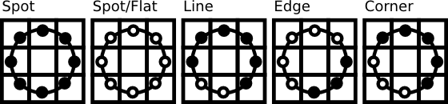
Image Courtesy: OpenCV documentation

Slide 12
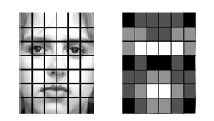
Image divide

Slide 13
LBP Histograms
We appended 42 (one for each part of the image) 59-bin histograms.
So for every image we got a feature vector of size (42*59) 2478.

Slide 14
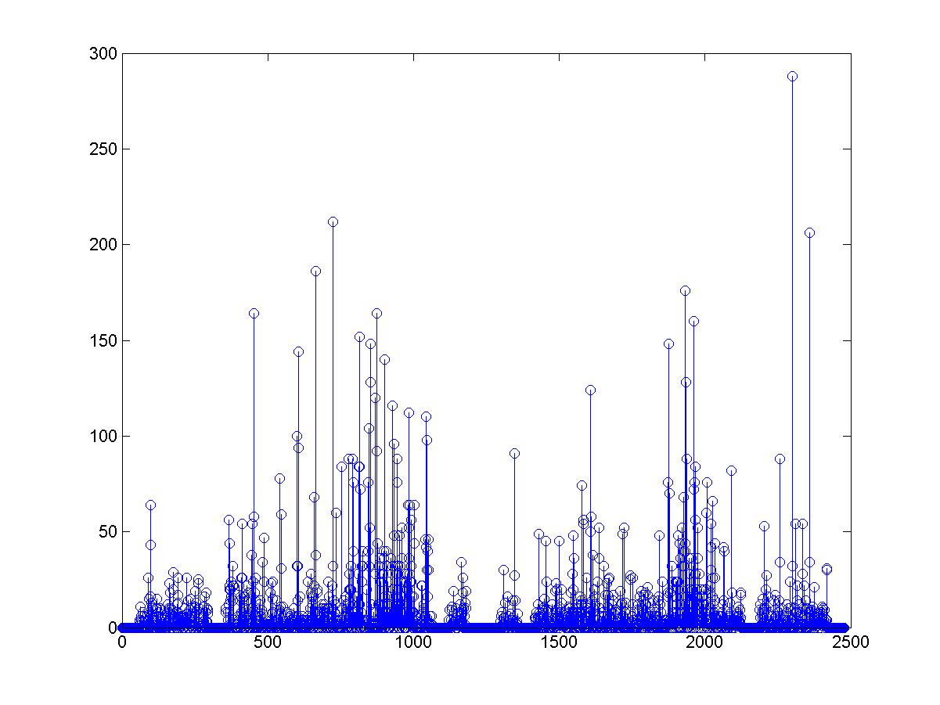
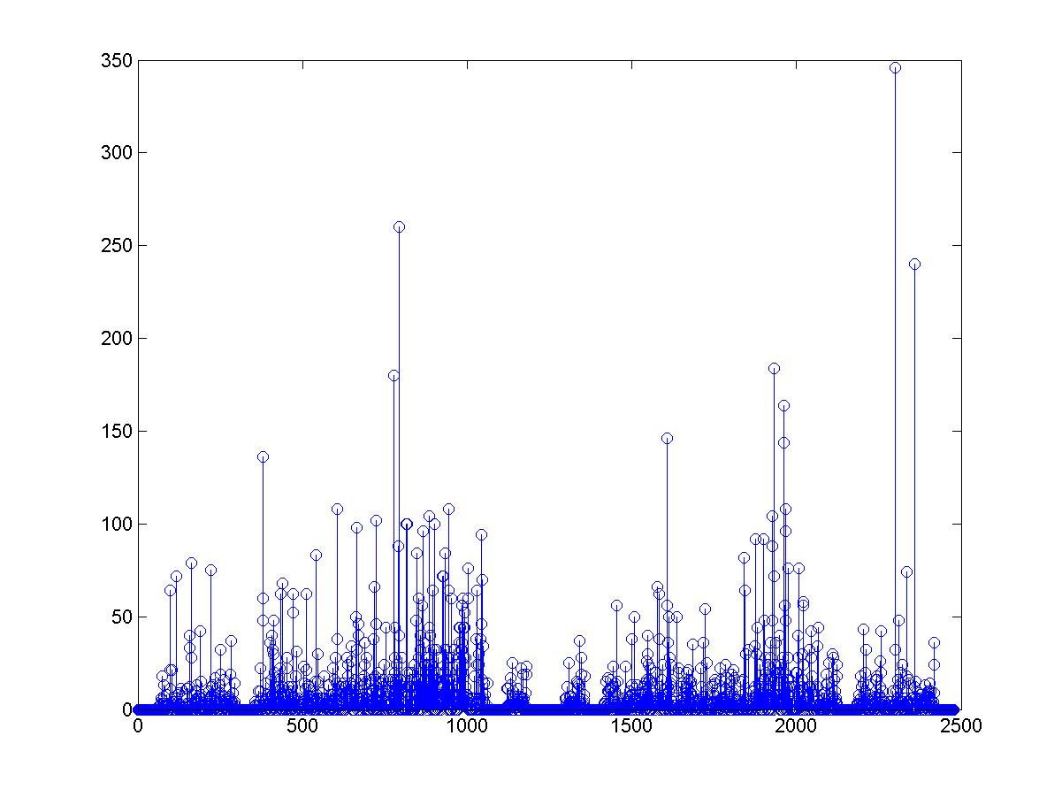
Comparison of histogram for different expressions
Sub. 1 [Surprise]
Sub. 2 [Surprise]

Slide 15
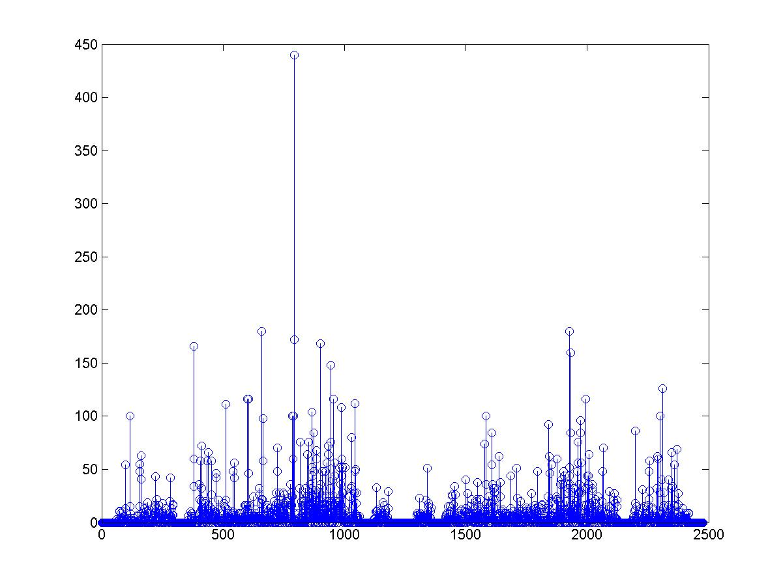
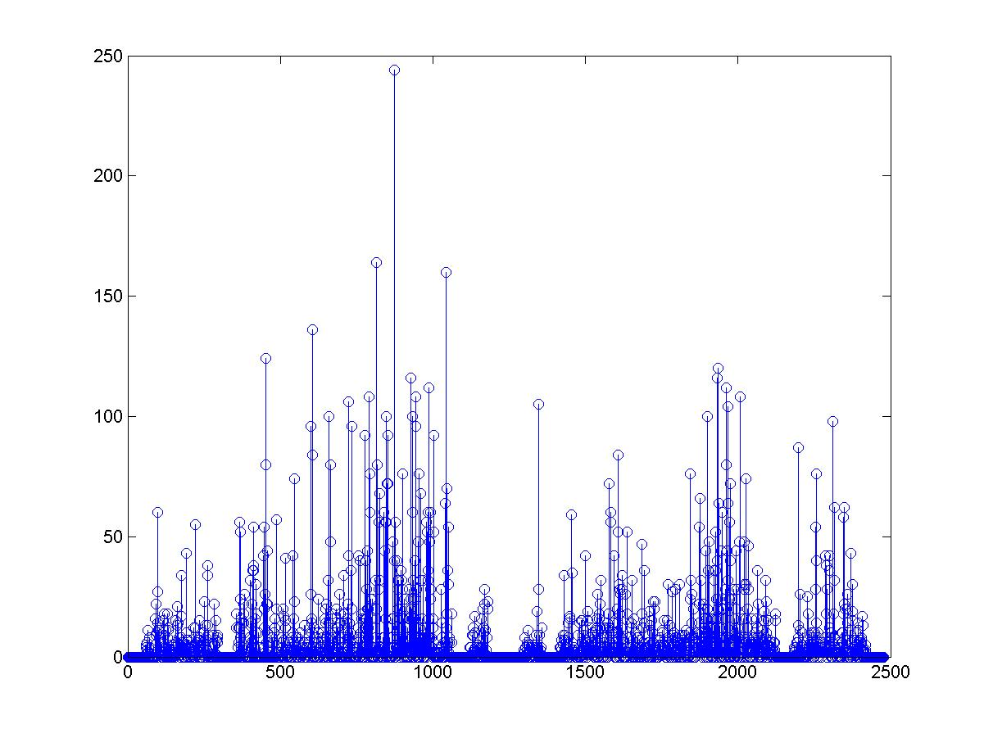
Comparison of histogram for different expressions
Sub. 1 [Sad]
Sub. 2 [Sad]

Slide 16
LBP with SVM
It was proven by [7]Shan et al that using LBP with SVM would give better results as compared to template matching or Linear Discriminant Analysis.

Slide 17
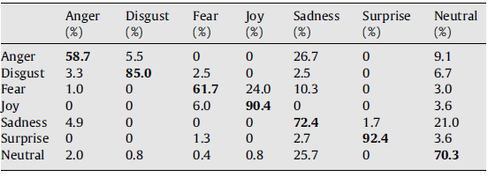
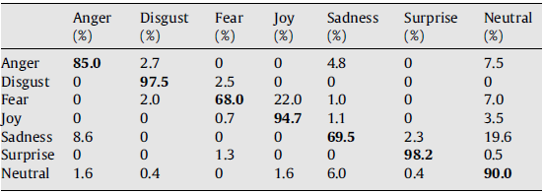

Table 1 Confusion Matrix for classifier using LBP and template matching.
Table 2 Confusion Matrix for classifier using LBP and SVM.
Table 3 Comparison between LDA + NN and SVM (linear) for facial expression recognition using LBP features
Data Courtesy: [7]Shang et al.

Slide 18
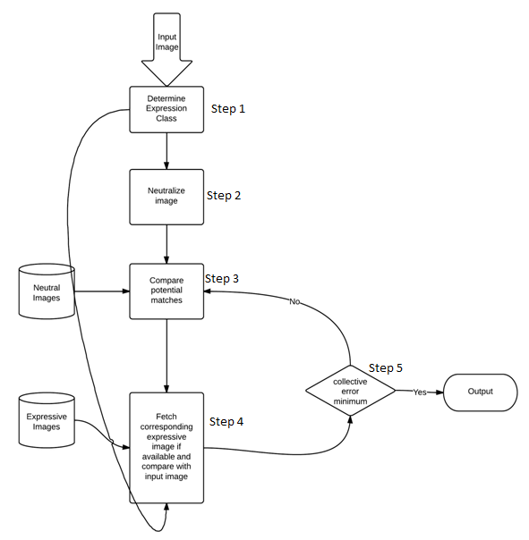
Implementation design
Determine the expression class of input image. The first step would be to classify the input image according to its relevant expression. As we know that using LBP with SVM is a proven method to classify images according to a particular feature and hence we use the same for this purpose. Once we are done with this we get the expression tag for the input image.
Neutralize input image and remove expression variations.
Once we are done classifying the input image, next logical step would be to remove the expressional dependencies from the image thus rendering an expression-free neutral image.
Generally two types of transformation can be used to achieve above result. First is to use direct facial expression transformation in which we assume that we will be provided with a target neutral image which will be used to neutralize the input image. However, this assumption holds only in the case authentication system where we know the user information(both image and relevant user tag).
Hence we use indirect facial expression transformation as proposed by [3]Zhou and Lin (2005) in which no such prerequisites are mentioned.
Now we check for the potential matches of the neutralized input image in dataset of neutral image.
This searching is done using Euclidian distance measure with some threshold.
For every potential match found in the previous step we calculate distance between corresponding image from dataset of expressive images if such an image is available.
Finally we output the label which has minimum collective error value

Slide 19
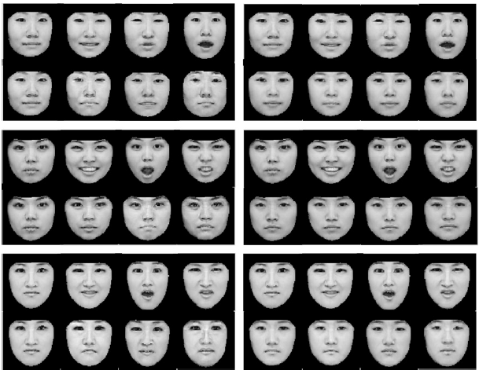
Indirect Facial Expression Transformation

Slide 20
References
Pohsiang Tsai *, Longbing Cao, Tom Hintz, Tony Jan, 2009. A bi-modal face recognition framework integrating facial expression with facial appearance. Elsevier Pattern Recognition Letters 30 (2009) 1096–1109.
Hyung-Soo Lee, Daijin Kim, 2008. Expression-invariant face recognition by facial expression transformations. Elsevier Pattern Recognition Letters 29 (2008) 1797–1805.
Chao-Kuei Hsieh, Shang-Hong Lai, Yung-Chang Chen, 2009. Expression-Invariant Face Recognition With Constrained Optical Flow Warping. IEEE Transactions on multimedia, vol. 11, no. 4, June 2009.
Vasant Manohar, Matthew Shreve, Dmitry Goldgof, Sudeep Sarkar, 2010. Modeling Facial Skin Motion Properties in Video and its Application to Matching Faces Across Expressions. 2010 International Conference on Pattern Recognition
Kanade, T., Cohn, J. F., & Tian, Y. (2000). Comprehensive database for facial expression analysis. Proceedings of the Fourth IEEE International Conference on Automatic Face and Gesture Recognition (FG'00), Grenoble, France, 46-53.
Lucey P., Cohn, J. F., Kanade, T., Saragih, J., Ambadar, Z., & Matthews, I. (2010). The Extended Cohn-Kanade Dataset (CK+): A complete expression dataset for action unit and emotion-specified expression. Proceedings of the Third International Workshop on CVPR for Human Communicative Behavior Analysis (CVPR4HB 2010), San Francisco, USA, 94-101.
Caeifeng Shan, Shaogang Gong, Peter W. McOwan(2009). Facial expression recognition based on Local Binary Patterns: A comprehensive study. Elsevier Image and Vision Computing 27 (2009) 808-816.

Slide 21
Thank You

